Slide 1
Chapter 5 Concurrency: Mutual Exclusion and Synchronization
Operating Systems: Internals and Design Principles
Ninth Edition
By William Stallings
Notes:
“Operating Systems: Internals and Design Principles”, 9/e, by William Stallings, Chapter 5 “Concurrency: Mutual Exclusion and Synchronization”.

Slide 2
Multiple Processes
Operating System design is concerned with the management of processes and threads:
Multiprogramming
The management of multiple processes within a uniprocessor system
Multiprocessing
The management of multiple processes within a multiprocessor
Distributed Processing
The management of multiple processes executing on multiple, distributed computer systems
The recent proliferation of clusters is a prime example of this type of system
Notes:
The central themes of operating system design are all concerned with the management of processes and threads:
• Multiprogramming: The management of multiple processes within a uniprocessor system
• Multiprocessing : The management of multiple processes within a multiprocessor
• Distributed processing: The management of multiple processes executing on multiple, distributed computer systems. The recent proliferation of clusters is a prime example of this type of system.

Slide 3
Concurrency Arises in Three Different Contexts:
Multiple Applications
Invented to allow processing time to be shared among active applications
Structured Applications
Extension of modular design and structured programming
Operating System Structure
OS themselves implemented as a set of processes or threads
Notes:
Fundamental to all of these areas, and fundamental to OS design, is concurrency. Concurrency encompasses a host of design issues, including communication among processes, sharing of and competing for resources (such as memory, files, and I/O access), synchronization of the activities of multiple processes, and allocation of processor time to processes. We shall see that these issues arise not just in multiprocessing and distributed processing environments but even in single-processor multiprogramming systems.
Concurrency arises in three different contexts:
• Multiple applications: Multiprogramming was invented to allow processing time to be dynamically shared among a number of active applications.
• Structured applications: As an extension of the principles of modular design and structured programming, some applications can be effectively programmed as a set of concurrent processes.
Operating system structure: The same structuring advantages apply to systems programs, and we have seen that operating systems are themselves often implemented as a set of processes or threads.

Slide 4

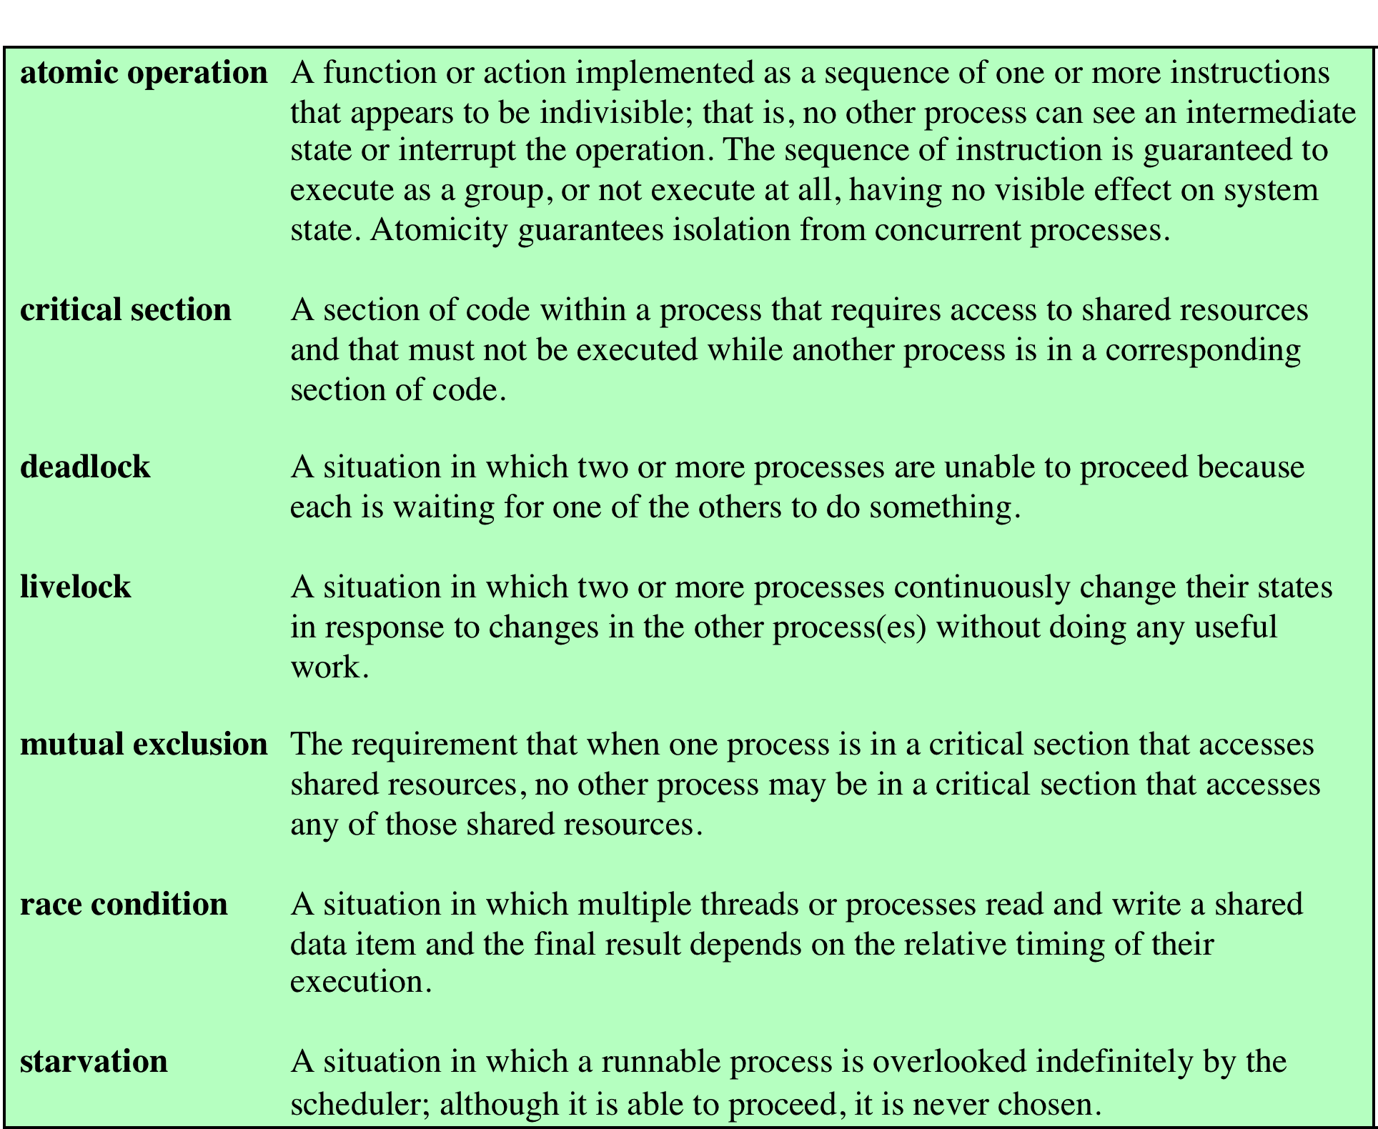
Table 5.1
Some Key Terms Related
to Concurrency
Notes:
Table 5.1 lists some
key terms related to concurrency. A set of animations that illustrate concepts in this
chapter is available at the Companion website for this book.

Slide 5
Mutual Exclusion: Software Approaches
Software approaches can be implemented for concurrent processes that execute on a single-processor or a multiprocessor machine with shared main memory
These approaches usually assume elementary mutual exclusion at the memory access level
Simultaneous accesses (reading and/or writing) to the same location in main memory are serialized by some sort of memory arbiter, although the order of access granting is not specified ahead of time
Beyond this, no support in the hardware, operating system, or programming language is assumed
Dijkstra reported an algorithm for mutual exclusion for two processes, designed by the Dutch mathematician Dekker
Following Dijkstra, we develop the solution in stages
This approach has the advantage if illustrating many of the common bugs encountered in developing concurrent programs
Notes:
Software approaches can be implemented for concurrent processes that execute on
a single-processor or a multiprocessor machine with shared main memory. These
approaches usually assume elementary mutual exclusion at the memory access level
([LAMP91], but see Problem 5.3). That is, simultaneous accesses (reading and/or
writing) to the same location in main memory are serialized by some sort of memory
arbiter, although the order of access granting is not specified ahead of time. Beyond
this, no support in the hardware, operating system, or programming language is
assumed.
Dijkstra [DIJK65] reported an algorithm for mutual exclusion for two processes,
designed by the Dutch mathematician Dekker. Following Dijkstra, we develop the
solution in stages. This approach has the advantage of illustrating many of the common
bugs encountered in developing concurrent programs.

Slide 6
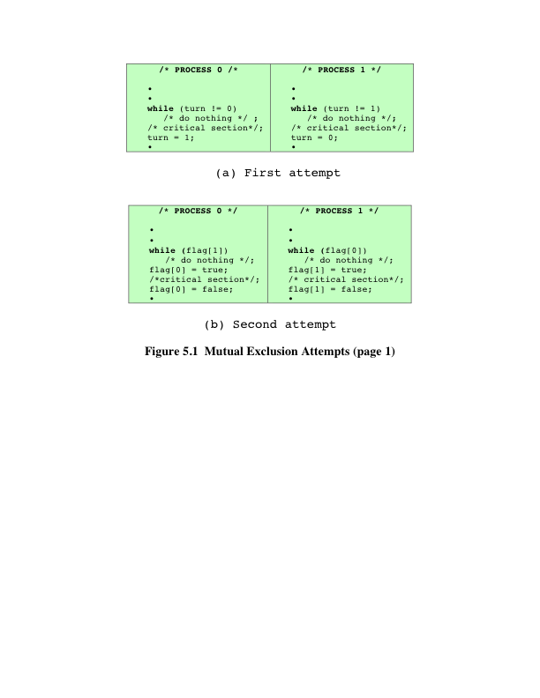
Notes:
First Attempt
As mentioned earlier, any attempt at mutual exclusion must rely
on some fundamental exclusion mechanism in the hardware. The most common of
these is the constraint that only one access to a memory location can be made at a
time. Using this constraint, we reserve a global memory location labeled turn. A
process (P0 or P1) wishing to execute its critical section first examines the contents
of turn. If the value of turn is equal to the number of the process, then the process
may proceed to its critical section. Otherwise, it is forced to wait. Our waiting process
repeatedly reads the value of turn until it is allowed to enter its critical section. This
procedure is known as busy waiting, or spin waiting, because the thwarted process
can do nothing productive until it gets permission to enter its critical section. Instead,
it must linger and periodically check the variable; thus it consumes processor time
(busy) while waiting for its chance.
After a process has gained access to its critical section, and after it has completed
that section, it must update the value of turn to that of the other process.
In formal terms, there is a shared global variable:
int turn = 0;
Figure 5.1a shows the program for the two processes. This solution guarantees
the mutual exclusion property but has two drawbacks. First, processes must strictly
alternate in their use of their critical section; therefore, the pace of execution is dictated
by the slower of the two processes. If P0 uses its critical section only once per
hour, but P1 would like to use its critical section at a rate of 1,000 times per hour, P1
is forced to adopt the pace of P0. A much more serious problem is that if one process
fails, the other process is permanently blocked. This is true whether a process fails in
its critical section or outside of it.
The foregoing construction is that of a coroutine . Coroutines are designed to
be able to pass execution control back and forth between themselves (see Problem
5.5). While this is a useful structuring technique for a single process, it is inadequate
to support concurrent processing.
Second Attempt
The flaw in the first attempt is that it stores the name of the
process that may enter its critical section, when in fact we need state information
about both processes. In effect, each process should have its own key to the critical
section so that if one fails, the other can still access its critical section. To meet this
requirement a Boolean vector flag is defined, with flag[0] corresponding to P0
and flag[1] corresponding to P1. Each process may examine the other’s flag but
may not alter it. When a process wishes to enter its critical section, it periodically
checks the other’s flag until that flag has the value false, indicating that the other
process is not in its critical section. The checking process immediately sets its own
flag to true and proceeds to its critical section. When it leaves its critical section, it
sets its flag to false.
The shared global variable now is
enum boolean (false = 0; true = 1);
boolean flag[2] = 0, 0
Figure 5.1b shows the algorithm. If one process fails outside the critical section,
including the flag-setting code, then the other process is not blocked. In fact, the other
process can enter its critical section as often as it likes, because the flag of the
other process is always false. However, if a process fails inside its critical section
or after setting its flag to true just before entering its critical section, then the other
process is permanently blocked.
This solution is, if anything, worse than the first attempt because it does not
even guarantee mutual exclusion. Consider the following sequence:
P0 executes the while statement and finds flag[1] set to false
Pl executes the while statement and finds flag[0] set to false
P0 sets flag[0] to true and enters its critical section
Pl sets flag[1] to true and enters its critical section
Because both processes are now in their critical sections, the program is incorrect.
The problem is that the proposed solution is not independent of relative process
execution speeds.

Slide 7
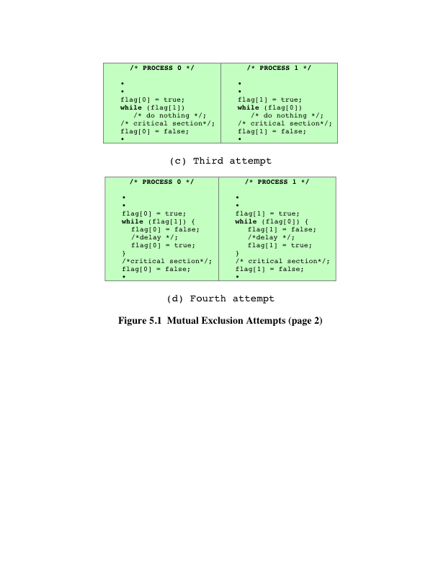
Notes:
Third Attempt
Because a process can change its state after the other process
has checked it but before the other process can enter its critical section, the second
attempt failed. Perhaps we can fix this problem with a simple interchange of two
statements, as shown in Figure 5.1c.
As before, if one process fails inside its critical section, including the flag-setting
code controlling the critical section, then the other process is blocked, and if a process
fails outside its critical section, then the other process is not blocked.
Next, let us check that mutual exclusion is guaranteed, using the point of view
of process P0. Once P0 has set flag[0] to true , Pl cannot enter its critical section
until after P0 has entered and left its critical section. It could be that Pl is already in
its critical section when P0 sets its flag. In that case, P0 will be blocked by the while
statement until Pl has left its critical section. The same reasoning applies from the
point of view of Pl.
This guarantees mutual exclusion, but creates yet another problem. If both
processes set their flags to true before either has executed the while statement,
then each will think that the other has entered its critical section, causing
deadlock.
Fourth Attempt
In the third attempt, a process sets its state without knowing the
state of the other process. Deadlock occurs because each process can insist on its right
to enter its critical section; there is no opportunity to back off from this position. We
can try to fix this in a way that makes each process more deferential: Each process
sets its flag to indicate its desire to enter its critical section, but is prepared to reset
the flag to defer to the other process, as shown in Figure 5.1d.
This is close to a correct solution, but is still flawed. Mutual exclusion is still
guaranteed, using similar reasoning to that followed in the discussion of the third
attempt. However, consider the following sequence of events:
P0 sets flag[0] to true.
Pl sets flag[1] to true.
P0 checks flag[1] .
Pl checks flag[0] .
P0 sets flag[0] to false .
Pl sets flag[1] to false .
P0 sets flag[0] to true .
Pl sets flag[1] to true .
This sequence could be extended indefinitely, and neither process could enter
its critical section. Strictly speaking, this is not deadlock, because any alteration in the
relative speed of the two processes will break this cycle and allow one to enter the
critical section. This condition is referred to as livelock . Recall that deadlock occurs
when a set of processes wishes to enter their critical sections, but no process can succeed.
With livelock, there are possible sequences of executions that succeed, but it is
also possible to describe one or more execution sequences in which no process ever
enters its critical section.
Although the scenario just described is not likely to be sustained for very long,
it is nevertheless a possible scenario. Thus, we reject the fourth attempt.

Slide 8
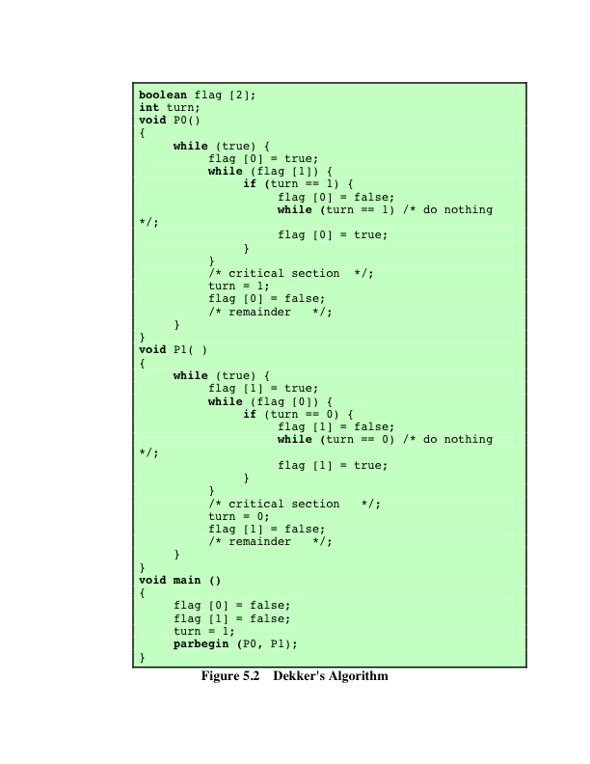
Dekker’s Algorithm.
It works
Three (3) nested loops
Easy to follow
While tracing it, be careful with the shared variables.
Parbegin( P0, P1) is simply a function that will create two concurrent processes or threads
It is the first known correct solution to the mutual exclusion problem in concurrent programming
Explained step by step in the board
Notes:
A Correct Solution We need to be able to observe the state of both processes,
which is provided by the array variable flag . But, as the fourth attempt shows, this is
not enough. We must impose an order on the activities of the two processes to avoid
the problem of ”mutual courtesy” that we have just observed. The variable turn
from the first attempt can be used for this purpose; in this case the variable indicates
which process has the right to insist on entering its critical region.
We can describe this solution, referred to as Dekker’s algorithm, as follows.
When P0 wants to enter its critical section, it sets its flag to true . It then checks the
flag of Pl. If that is false , P0 may immediately enter its critical section. Otherwise,
P0 consults turn . If P0 finds that turn = 0 , then it knows that it is its turn to insist
and periodically checks Pl’s flag. Pl will at some point note that it is its turn to defer
and set its to flag false , allowing P0 to proceed. After P0 has used its critical section,
it sets its flag to false to free the critical section, and sets turn to l to transfer the
right to insist to Pl.
Figure 5.2 provides a specification of Dekker’s algorithm. The construct
parbegin (Pl, P2, . . . , Pn ) means the following: suspend the execution of the main
program; initiate concurrent execution of procedures Pl, P2, . . . , Pn ; when all of Pl,
P2, . . . , Pn have terminated, resume the main program. A verification of Dekker’s
algorithm is left as an exercise (see Problem 5.l).

Slide 9
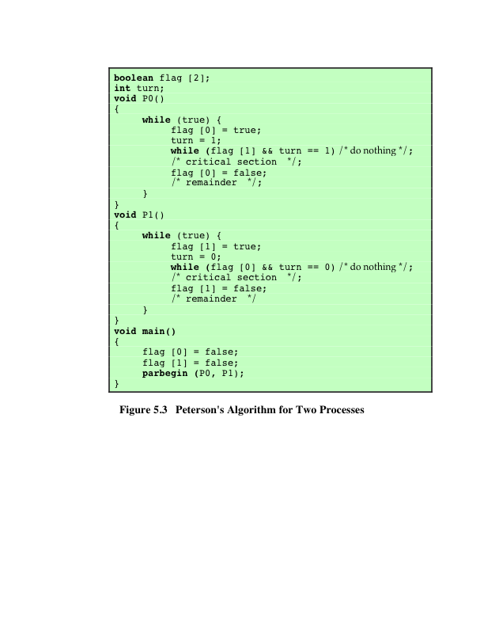
Peterson’s Algorithm.
It works
When compared to Dekker’s algorithm, it is easy to observe that this implementation is more efficient.
One “while” loop is eliminated
The most inner loop makes very good use of Boolean conditions
Easy to follow
While tracing it, be careful with the shared variables.
Parbegin( P0, P1) is simply a function that will create two concurrent processes or threads
Explained step by step in the board
Notes:
Dekker’s algorithm solves the mutual exclusion problem, but with a rather complex
program that is difficult to follow and whose correctness is tricky to prove. Peterson
[PETE8l] has provided a simple, elegant solution. As before, the global array variable
flag indicates the position of each process with respect to mutual exclusion, and
the global variable turn resolves simultaneity conflicts. The algorithm is presented
in Figure 5.3.
That mutual exclusion is preserved is easily shown. Consider process P0.
Once it has set flag[0] to true , Pl cannot enter its critical section. If Pl already
is in its critical section, then flag[1] = true and P0 is blocked from entering its
critical section. On the other hand, mutual blocking is prevented. Suppose that P0
is blocked in its while loop. This means that flag[1] is true and turn = l . P0 can
enter its critical section when either flag[1] becomes false or turn becomes 0.
Now consider three exhaustive cases:
1. Pl has no interest in its critical section. This case is impossible, because it implies
flag[1] = false .
2. Pl is waiting for its critical section. This case is also impossible, because if
turn = l , Pl is able to enter its critical section.
3. Pl is using its critical section repeatedly and therefore monopolizing access to it.
This cannot happen, because Pl is obliged to give P0 an opportunity by setting
turn to 0 before each attempt to enter its critical section.
Thus, we have a simple solution to the mutual exclusion problem for two processes.
Furthermore, Peterson’s algorithm is easily generalized to the case of processes
[HOFR90].

Slide 10
Peterson’s Algorithm.
It works
When compared to Dekker’s algorithm, it is easy to observe that this implementation is more efficient.
One “while” loop is eliminated
The most inner loop makes very good use of Boolean conditions
Easy to follow
While tracing it, be careful with the shared variables.
Parbegin( P0, P1) is simply a function that will create two concurrent processes or threads
Explained step by step in the board
Notes:
Dekker’s algorithm solves the mutual exclusion problem, but with a rather complex
program that is difficult to follow and whose correctness is tricky to prove. Peterson
[PETE8l] has provided a simple, elegant solution. As before, the global array variable
flag indicates the position of each process with respect to mutual exclusion, and
the global variable turn resolves simultaneity conflicts. The algorithm is presented
in Figure 5.3.
That mutual exclusion is preserved is easily shown. Consider process P0.
Once it has set flag[0] to true , Pl cannot enter its critical section. If Pl already
is in its critical section, then flag[1] = true and P0 is blocked from entering its
critical section. On the other hand, mutual blocking is prevented. Suppose that P0
is blocked in its while loop. This means that flag[1] is true and turn = l . P0 can
enter its critical section when either flag[1] becomes false or turn becomes 0.
Now consider three exhaustive cases:
1. Pl has no interest in its critical section. This case is impossible, because it implies
flag[1] = false .
2. Pl is waiting for its critical section. This case is also impossible, because if
turn = l , Pl is able to enter its critical section.
3. Pl is using its critical section repeatedly and therefore monopolizing access to it.
This cannot happen, because Pl is obliged to give P0 an opportunity by setting
turn to 0 before each attempt to enter its critical section.
Thus, we have a simple solution to the mutual exclusion problem for two processes.
Furthermore, Peterson’s algorithm is easily generalized to the case of processes
[HOFR90].

Slide 11
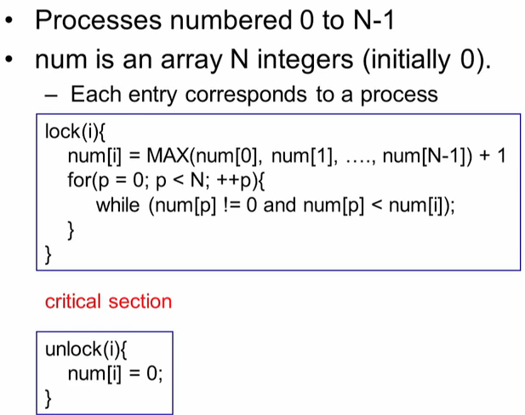
Simplified Bakery Algorithm.
Explained step by step in the board
Notes:
Dekker’s algorithm solves the mutual exclusion problem, but with a rather complex
program that is difficult to follow and whose correctness is tricky to prove. Peterson
[PETE8l] has provided a simple, elegant solution. As before, the global array variable
flag indicates the position of each process with respect to mutual exclusion, and
the global variable turn resolves simultaneity conflicts. The algorithm is presented
in Figure 5.3.
That mutual exclusion is preserved is easily shown. Consider process P0.
Once it has set flag[0] to true , Pl cannot enter its critical section. If Pl already
is in its critical section, then flag[1] = true and P0 is blocked from entering its
critical section. On the other hand, mutual blocking is prevented. Suppose that P0
is blocked in its while loop. This means that flag[1] is true and turn = l . P0 can
enter its critical section when either flag[1] becomes false or turn becomes 0.
Now consider three exhaustive cases:
1. Pl has no interest in its critical section. This case is impossible, because it implies
flag[1] = false .
2. Pl is waiting for its critical section. This case is also impossible, because if
turn = l , Pl is able to enter its critical section.
3. Pl is using its critical section repeatedly and therefore monopolizing access to it.
This cannot happen, because Pl is obliged to give P0 an opportunity by setting
turn to 0 before each attempt to enter its critical section.
Thus, we have a simple solution to the mutual exclusion problem for two processes.
Furthermore, Peterson’s algorithm is easily generalized to the case of processes
[HOFR90].

Slide 12
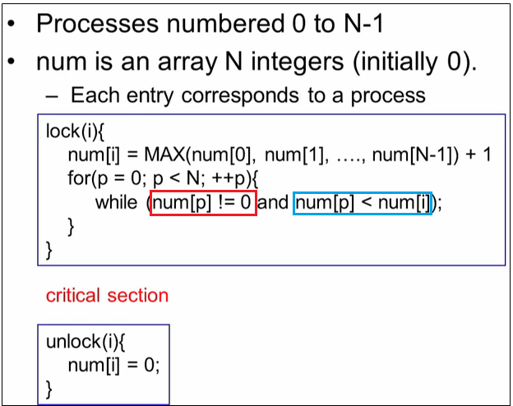
Simplified Bakery Algorithm.
Explained step by step in the board
Notes:
Dekker’s algorithm solves the mutual exclusion problem, but with a rather complex
program that is difficult to follow and whose correctness is tricky to prove. Peterson
[PETE8l] has provided a simple, elegant solution. As before, the global array variable
flag indicates the position of each process with respect to mutual exclusion, and
the global variable turn resolves simultaneity conflicts. The algorithm is presented
in Figure 5.3.
That mutual exclusion is preserved is easily shown. Consider process P0.
Once it has set flag[0] to true , Pl cannot enter its critical section. If Pl already
is in its critical section, then flag[1] = true and P0 is blocked from entering its
critical section. On the other hand, mutual blocking is prevented. Suppose that P0
is blocked in its while loop. This means that flag[1] is true and turn = l . P0 can
enter its critical section when either flag[1] becomes false or turn becomes 0.
Now consider three exhaustive cases:
1. Pl has no interest in its critical section. This case is impossible, because it implies
flag[1] = false .
2. Pl is waiting for its critical section. This case is also impossible, because if
turn = l , Pl is able to enter its critical section.
3. Pl is using its critical section repeatedly and therefore monopolizing access to it.
This cannot happen, because Pl is obliged to give P0 an opportunity by setting
turn to 0 before each attempt to enter its critical section.
Thus, we have a simple solution to the mutual exclusion problem for two processes.
Furthermore, Peterson’s algorithm is easily generalized to the case of processes
[HOFR90].

Slide 13
Principles of Concurrency
Interleaving and overlapping
Can be viewed as examples of concurrent processing
Both present the same problems
Uniprocessor – the relative speed of execution of processes cannot be predicted
Depends on activities of other processes
The way the OS handles interrupts
Scheduling policies of the OS
Notes:
At first glance, it may seem that interleaving and overlapping represent fundamentally different modes of execution and present different problems. In fact, both techniques can be viewed as examples of concurrent processing, and both present the same problems. In the case of a uniprocessor, the problems stem from a basic characteristic of multiprogramming systems: The relative speed of execution of processes cannot be predicted. It depends on the activities of other processes, the way in which the OS handles interrupts, and the scheduling policies of the OS.

Slide 14
Difficulties of Concurrency
Sharing of global resources
Difficult for the OS to manage the allocation of resources optimally
Difficult to locate programming errors as results are not deterministic and reproducible
Notes:
The following difficulties arise:
1. The sharing of global resources is fraught with peril. For example, if two processes both make use of the same global variable and both perform reads and writes on that variable, then the order in which the various reads and writes are executed is critical. An example of this problem is shown in the following subsection.
2. It is difficult for the OS to manage the allocation of resources optimally. For example, process A may request use of, and be granted control of, a particular I/O channel and then be suspended before using that channel. It may be undesirable for the OS simply to lock the channel and prevent its use by other processes; indeed this may lead to a deadlock condition, as described in Chapter 6 .
3. It becomes very difficult to locate a programming error because results are typically not deterministic and reproducible (e.g., see [LEBL87, CARR89, SHEN02] for a discussion of this point).
All of the foregoing difficulties present themselves in a multiprocessor system as well, because here too the relative speed of execution of processes is unpredictable. A multiprocessor system must also deal with problems arising from the simultaneous execution of multiple processes. Fundamentally, however, the problems are the same as those for uniprocessor systems. This should become clear as the discussion proceeds.

